Slide 1
Android Study Jams
Prior Programming Experience Track: Session 1
Introduction and Kotlin basics
What is android study jams?
Android Study Jams are community-organized study groups for people to learn how to build Android apps in the Kotlin programming language, using the curriculum provided by Google.

Slide 2



it honestly feels like a superpower to know how to build an app..to take something that’s an idea in your head, and put it on your phone. And It’s not just your phone, there are over 2.5 billion android devices in the world. That’s phones, tablets, Tvs, watches, and even cars. Imagine how cool it would be to make an app that your friends can use
Notes:
After you pass the quiz, you earn a badge like this one!

Slide 3


Slide 4

Imagine how cool it would be to make an app that your friends can use

Slide 5
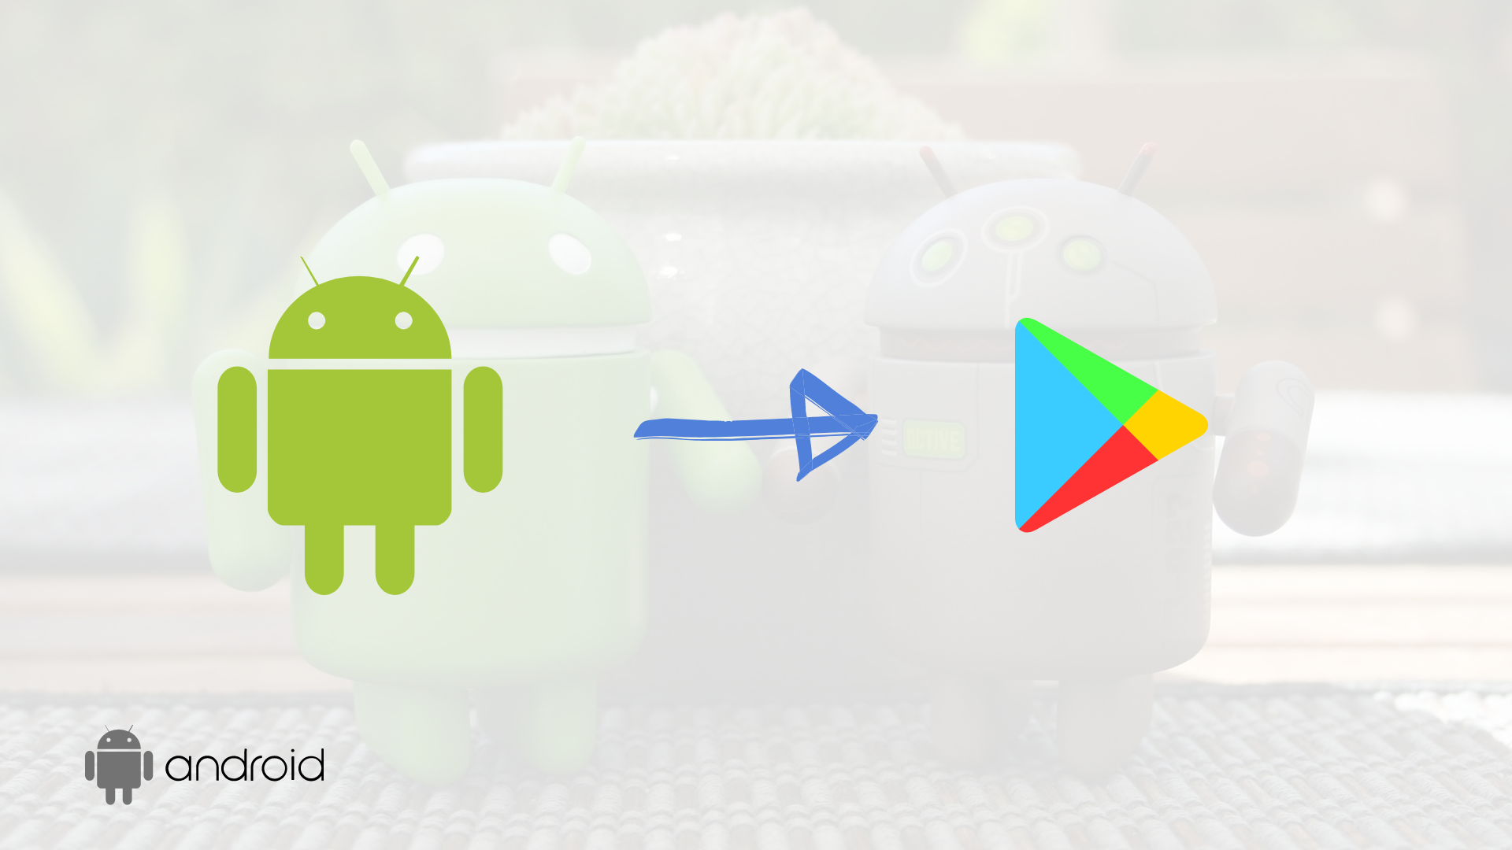

Slide 6

Get featured by Google
Selected apps will be showcased in blog format or on social media
Notes:
After you pass the quiz, you earn a badge like this one!

Slide 7
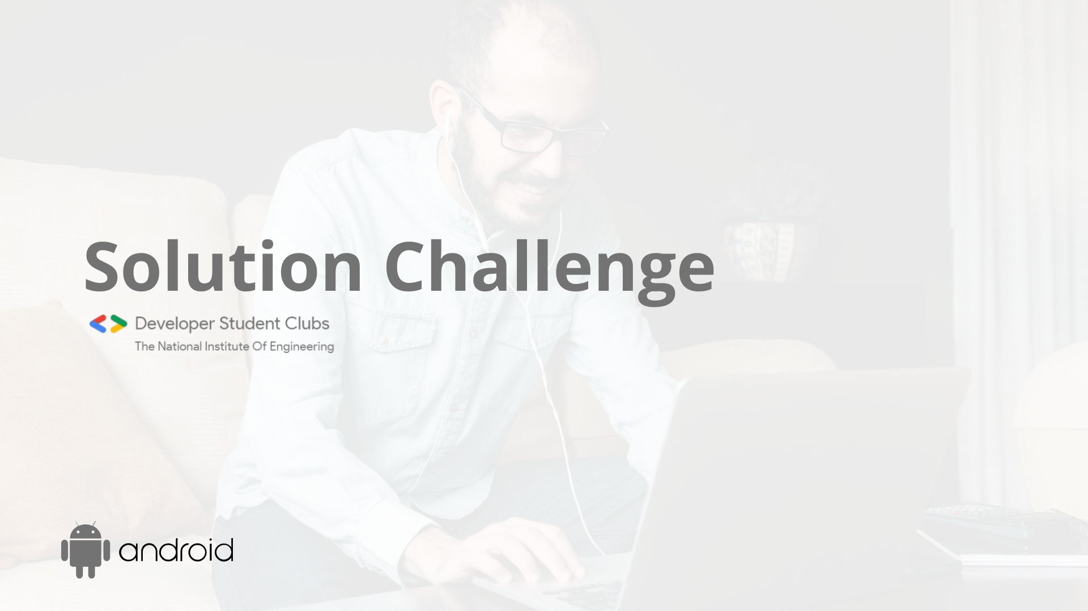

Slide 8

Learning Objectives
Learn the essentials of the Kotlin programming language
Build a variety of Android apps
Best practices for Android development
Discover resources to continue learning
2
Notes:
Let’s talk about what you will learn as part of this track of Android Study Jams. First you will learn the essentials of the Kotlin programming language, the language you’ll use to develop Android apps. Then you will install Android Studio on your computer and build a variety of Android apps in Kotlin by following the codelabs provided in the curriculum. Along the way, you will be learning best practices for Android, including app architecture and UI development. Another goal is to introduce you to the resources for where you can continue to learn Android development on your own.

Slide 9
Prerequisites
Programming experience in an OOP language
Computer
Internet connection
(Optional) Android Device and a USB cable
Notes:
Here are some the prerequisites that will be helpful for this first session of the track. As mentioned earlier, we assume that you already have programming experience in an object-oriented programming language. You will also need a computer with internet connection to do the exercises in this session.
[Mention WiFi instructions if necessary. Having access to an Android device is a nice-to-have starting in the next session, but not needed for this first session.]

Slide 10

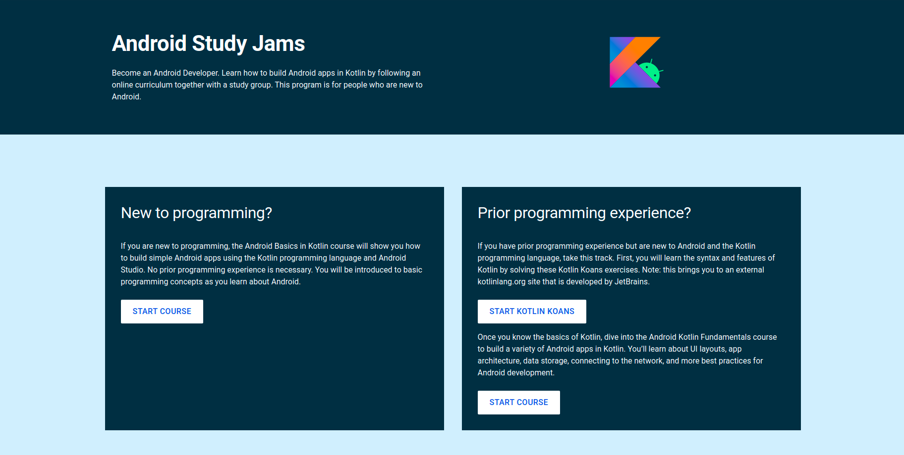
Choose a path
Notes:
You’ll be working through the Android Basics in Kotlin course. This is a free online training course developed by Google for people like yourself to learn how to build basic Android apps.

Slide 11
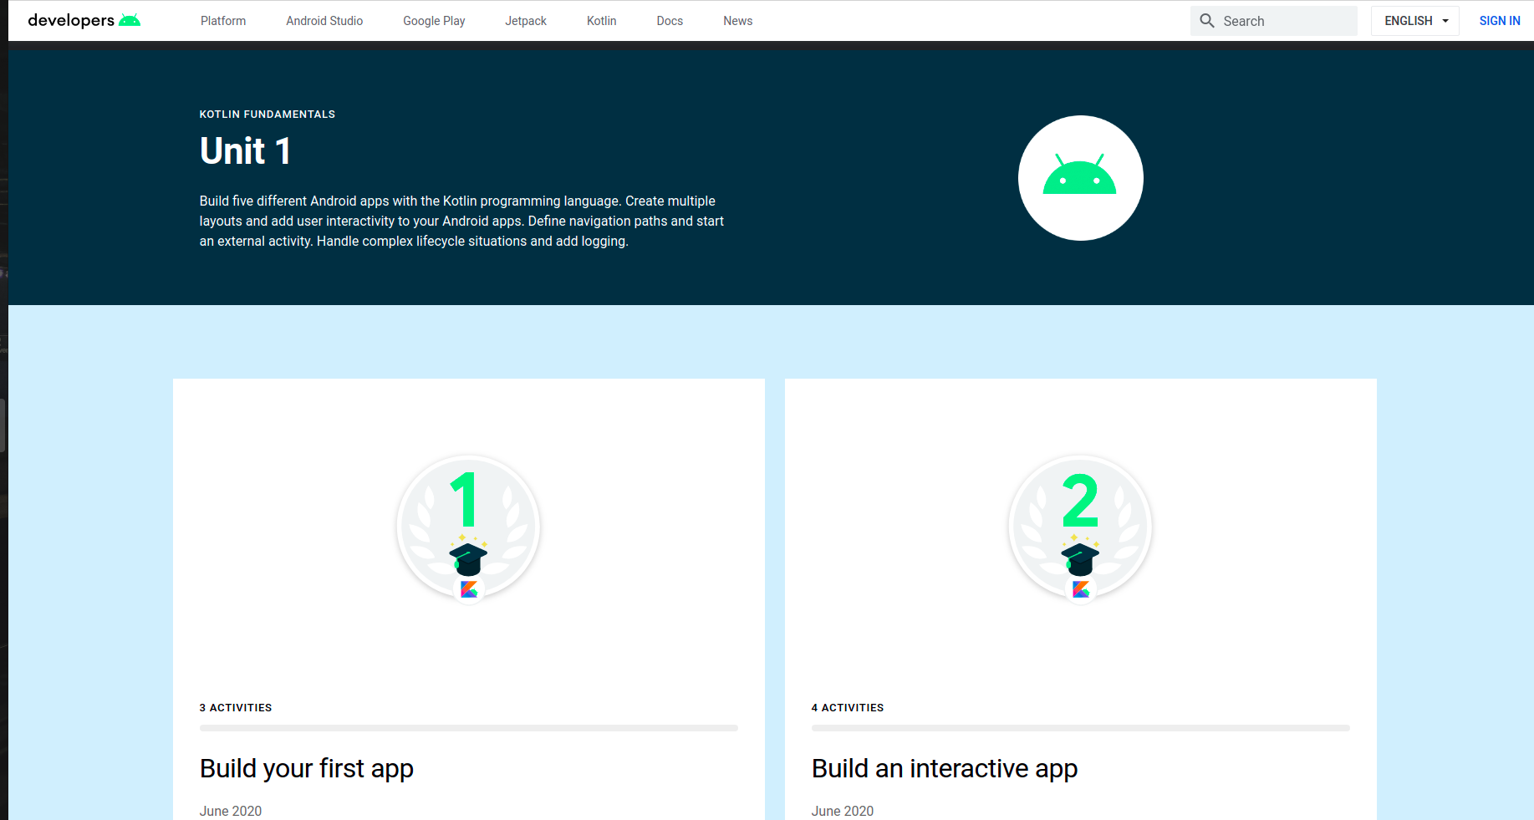
Unit 1: Kotlin Fundamentals
Notes:
The course is made up of units, and units are composed of pathways.
In this track, we’ll be focused on the first unit, which is shown here. It has made up of 4 pathways. In Session 1, you’ll work on the first 3 pathways: 1) Introduction to Kotlin, 2) Create your first app, and 3) Build a basic layout. In Session 2, you’ll work on the 4th pathway, which is a little longer.

Slide 12
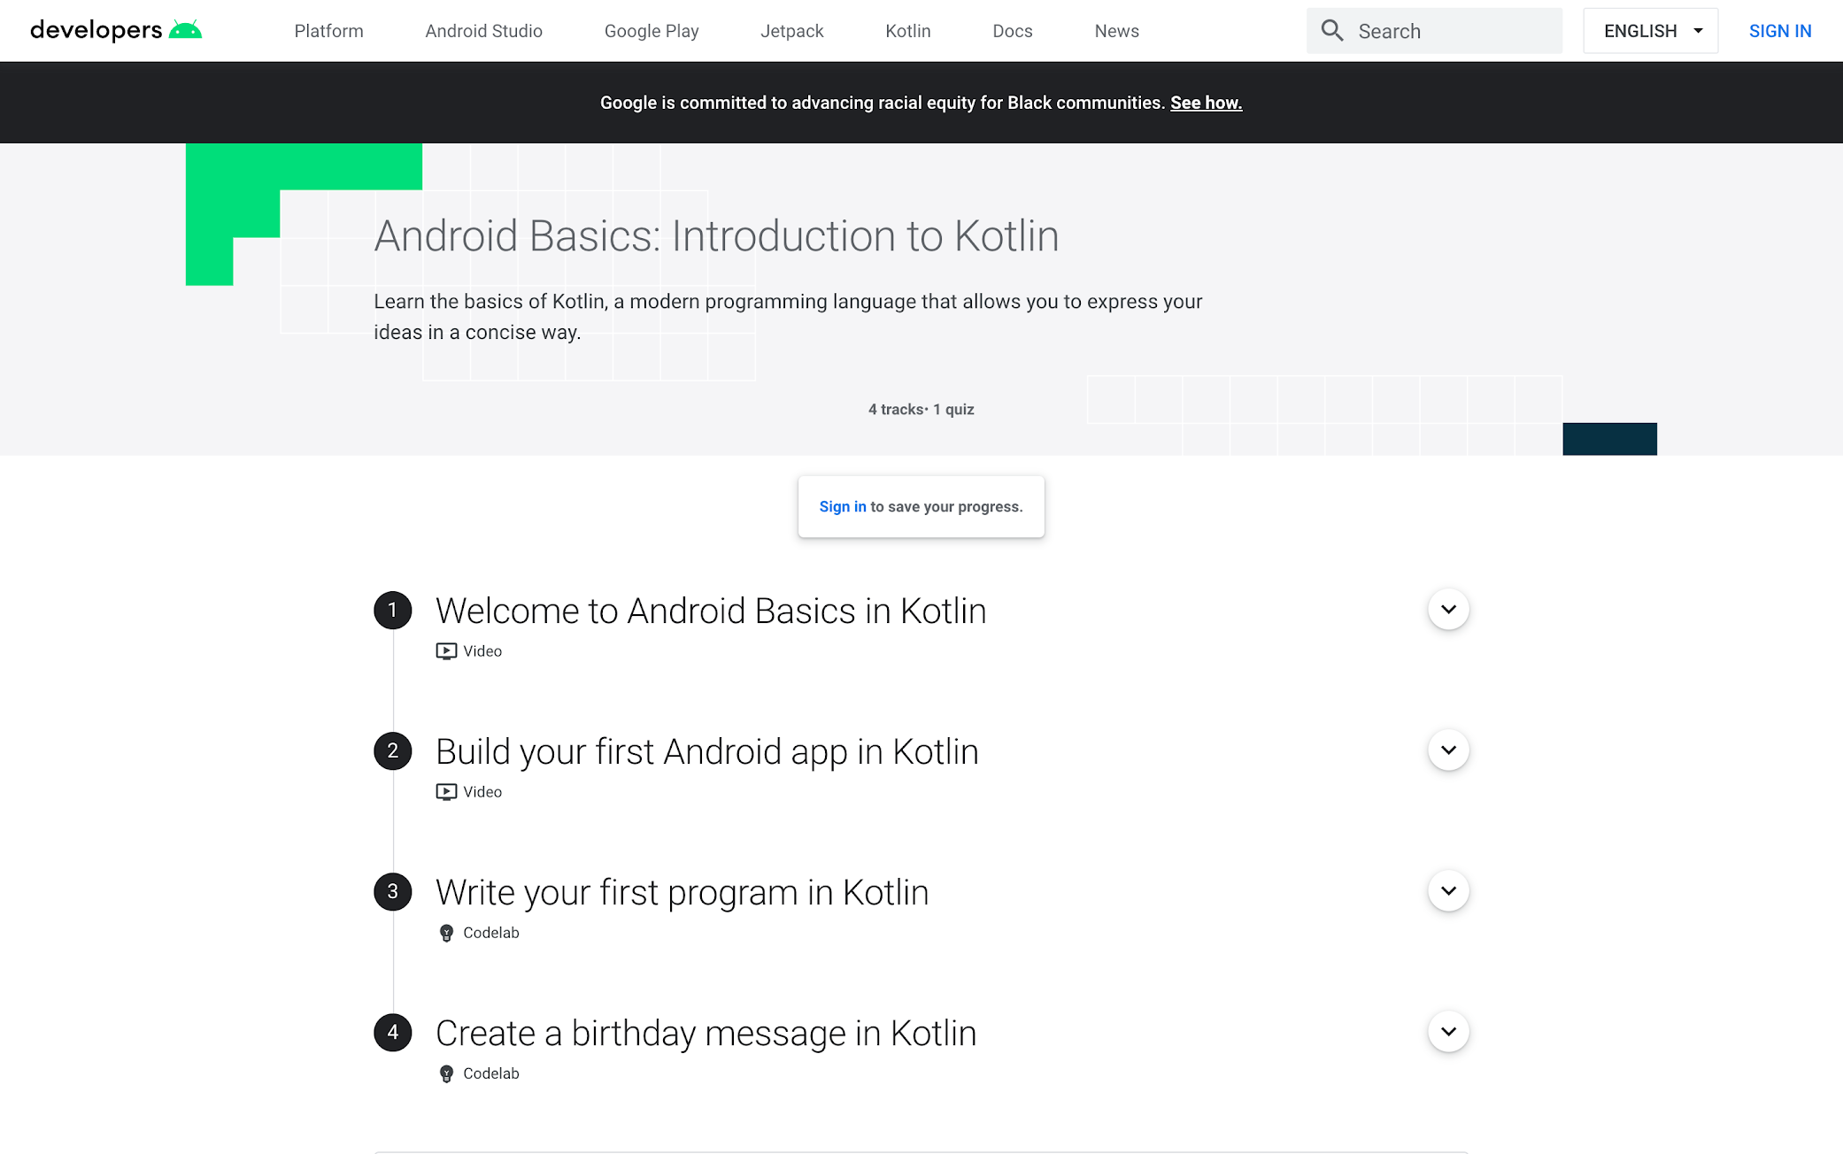
A Pathway
Notes:
You may be wondering, what is a pathway? It’s an ordered sequence of activities to learn a specific skill. An activity can be a video, hands-on coding tutorial (known as a codelab), an article, or quiz. You can see at least 4 activities in this first pathway. All these activities are meant to help you reach specific learning objectives by the end of this pathway.

Slide 13
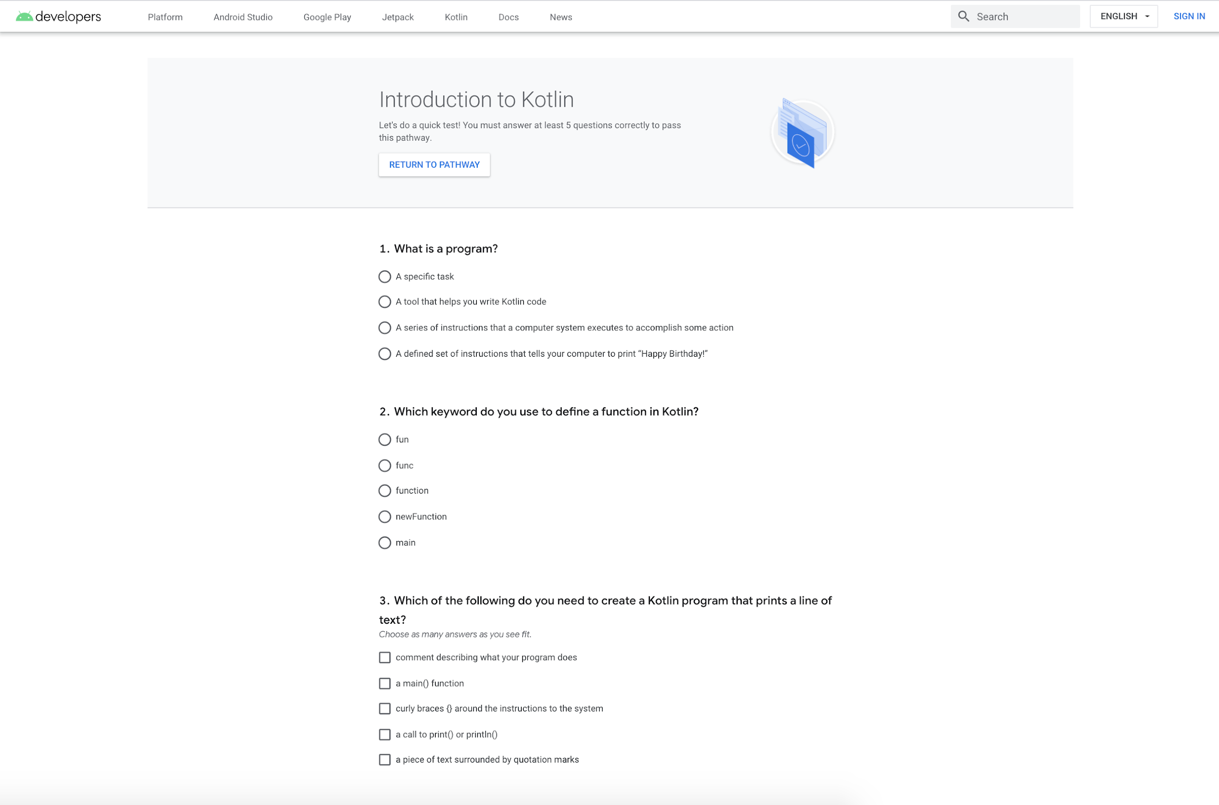
Take a Quiz
Notes:
There’s a quiz at the end of each pathway to check your understanding of what you just learned. Here’s what a sample quiz looks like. There are no limits to the number of retries for a quiz. But if you get a question wrong, try to understand what the concept is (even if you need to look back at the source material), before answering again.

Slide 14

Earn badges!
Notes:
After you pass the quiz, you earn a badge like this one!

Slide 15
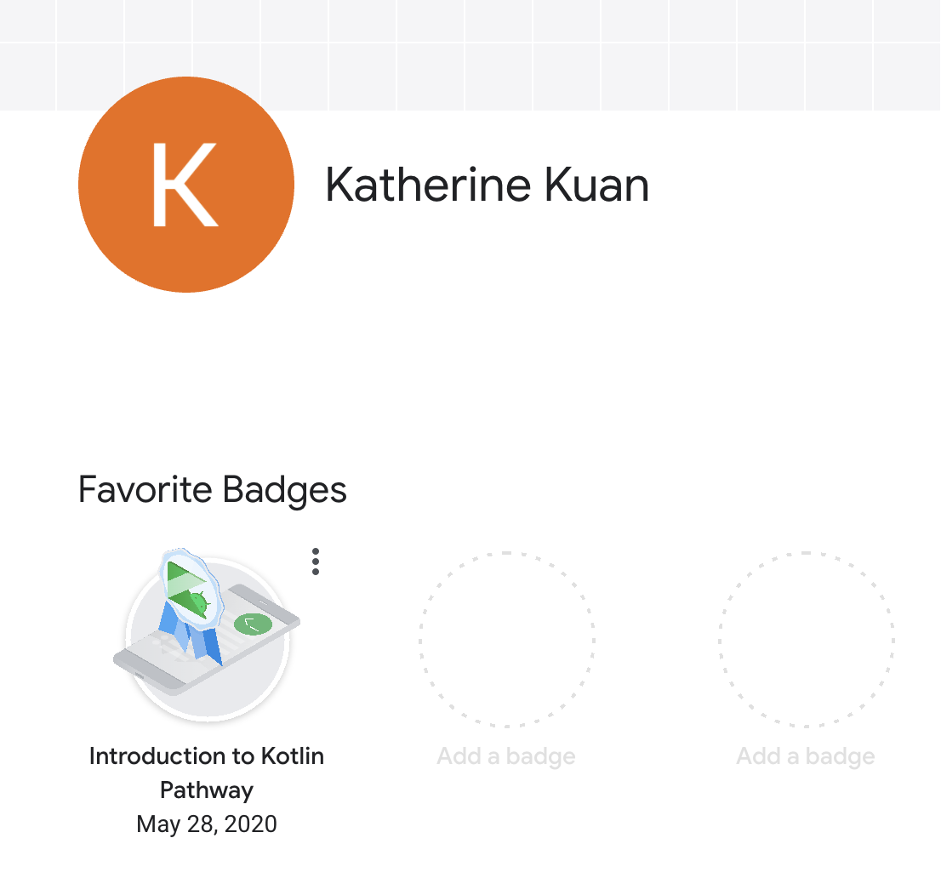

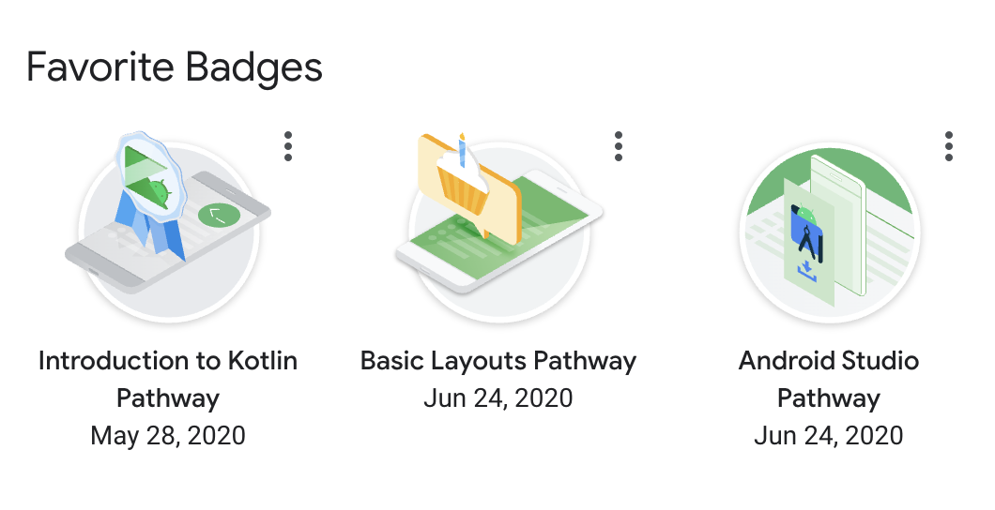
Developer profile
Carrie Sawyer
Photo by Christopher Campbell on Unsplash
Notes:
The badges you earn can be saved to your developer profile. When you are taking the course, be sure to sign in (in the top right corner) and create a developer profile if you haven’t already. It’s very quick to create. As you earn more badges, you can see them on your developer profile and favorite them, as shown here.
[Read more on the Google developer profile]

Slide 16

Start here:
g.co/android/studyjams
Collect your first badge!
Notes:
Start by opening up the landing page for Android Study Jams. You will automatically be awarded this badge for being a participant Android Study Jams! Save it to your developer profile, and create a profile if you haven’t already.

Slide 17
Let’s get started
Notes:
That covers the important concepts and logistics for the session, so let’s get started!

Slide 18
What’s your favorite programming language and why?
Notes:
Let’s start with a question so I can get to know a little more about you. What is your favorite programming language and why? You can take out a piece of paper and write your answers down.
[Give 2-3 minutes to work and when most people have put down their pencils, proceed.]
So, what did everyone write down?
[Generate a list of people’s answers]
Okay let’s keep those qualities in mind throughout today’s session, where you’ll be learning a new programming language: Kotlin!

Slide 19
Concept Overview
What is Kotlin?
Notes:
Alright, let’s dive in and answer this question: what is Kotlin?

Slide 20
Kotlin is a modern programming language that helps developers be more productive.
Notes:
Kotlin is a modern programming language that helps developers be more productive. It was started as a project by JetBrains in 2010 and was made open source under the Apache 2.0 license, with Kotlin 1.0 released in 2016. The language has quickly gained traction among the developer community and in industry. Kotlin is one of the fastest growing programming languages, according to GitHub.
Resources:
Kotlin
GitHub State of the Octoverse

Slide 21

Benefits of Kotlin
Expressive & Concise
Safer Code
Interoperable with Java
Notes:
These are some of the key benefits that developers enjoy with Kotlin:
The Kotlin language is expressive and concise, allowing you to express your ideas with less code. This reduces the amount of boilerplate code in your project.
Kotlin helps you write safer code, with features that help you minimize common programming errors like NullPointerExceptions.
Kotlin is 100% interoperable with Java, which means you can call Java-based code from Kotlin and vice-versa. If you already have an existing Android app in Java, you can add as little or as much Kotlin to the project as you want.
Another key benefit that Kotlin offers is structured concurrency with Kotlin coroutines. They simplify background task management for everything from network calls to accessing local data, which are common for mobile apps.
Kotlin has many great language features, and Kotlin is now the #4 most loved programming language according to the Stack Overflow’s 2020 Survey.
Resources:
Kotlin
Stack Overflow Developer Survey in 2020

Slide 22

Android Development is Kotlin-First
Notes:
How does this relate to Android development? In 2017, Google announced that Kotlin would be another officially supported language on Android. Then in 2019, Google announced that Android development would become increasingly Kotlin-first, so that new tools and libraries will first be made available in Kotlin. To further their commitment, Google and JetBrains formed the Kotlin Foundation to protect, promote, and advance the Kotlin language.
Within the span of several years, Kotlin has seen rapid adoption in the Android developer ecosystem. Over 70% of the top 1000 Android apps use Kotlin and 60% of professional Android developers use Kotlin. There has never been a better time to start learning Kotlin to take advantage of the latest features on Android.
On that note, let’s dive in and look at the basics of what Kotlin code looks like.
Resources:
Android's Kotlin-first approach

Slide 23
Logistics
Notes:
Let’s talk about how the rest of the session will work.

Slide 24
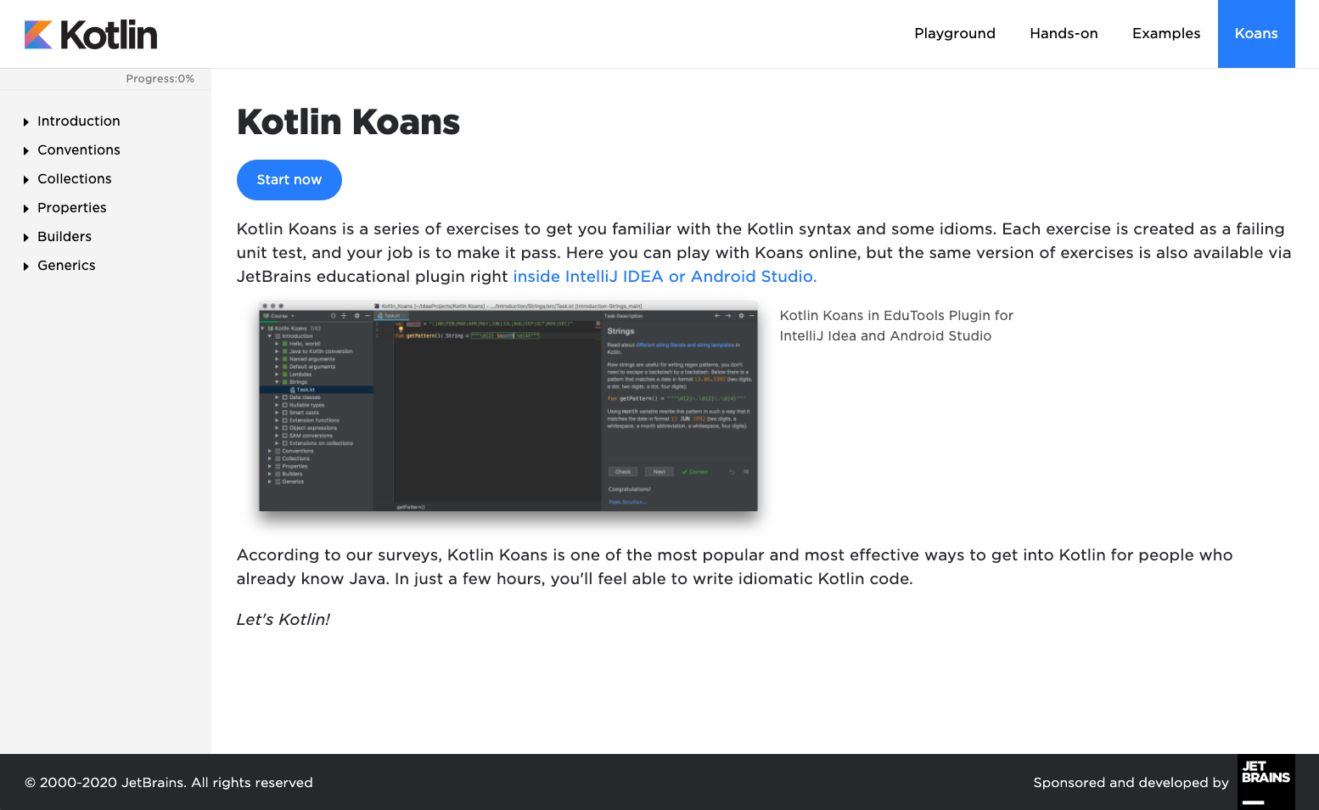
Kotlin Koans
Kotlin Koans are a series of exercises to get you familiar with the Kotlin Syntax. Each exercise is created as a failing unit test and your job is to make it pass.
Notes:
You’ll be working through Kotlin Koans, a set of interactive exercises on the Kotlin language website. These exercises will help you ramp up quickly on language syntax and important aspects of the Kotlin language.
If you’re wondering, what is a Koan? It’s a paradoxical riddle or puzzle. So Kotlin Koans is a fun play on words!

Slide 25
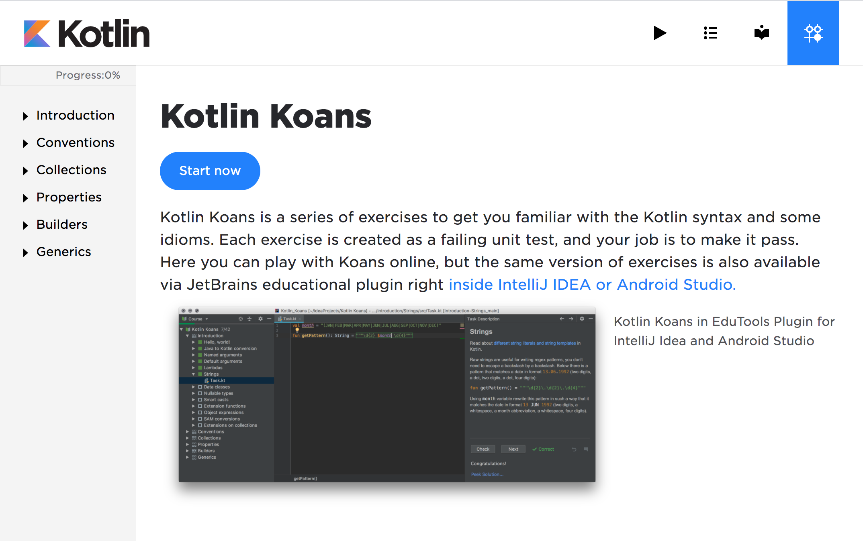
Kotlin Koans
Work on
first three categories
Notes:
To give you a brief tour of the interface, on the left-hand side, you’ll see the categories of exercises that you’ll work through. For this session together, work through the first 3 categories: Introduction, Conventions, Collections. Exercises in the later categories Properties, Builders, and Generics are optional. You can do them on your own time if you’d like.

Slide 26
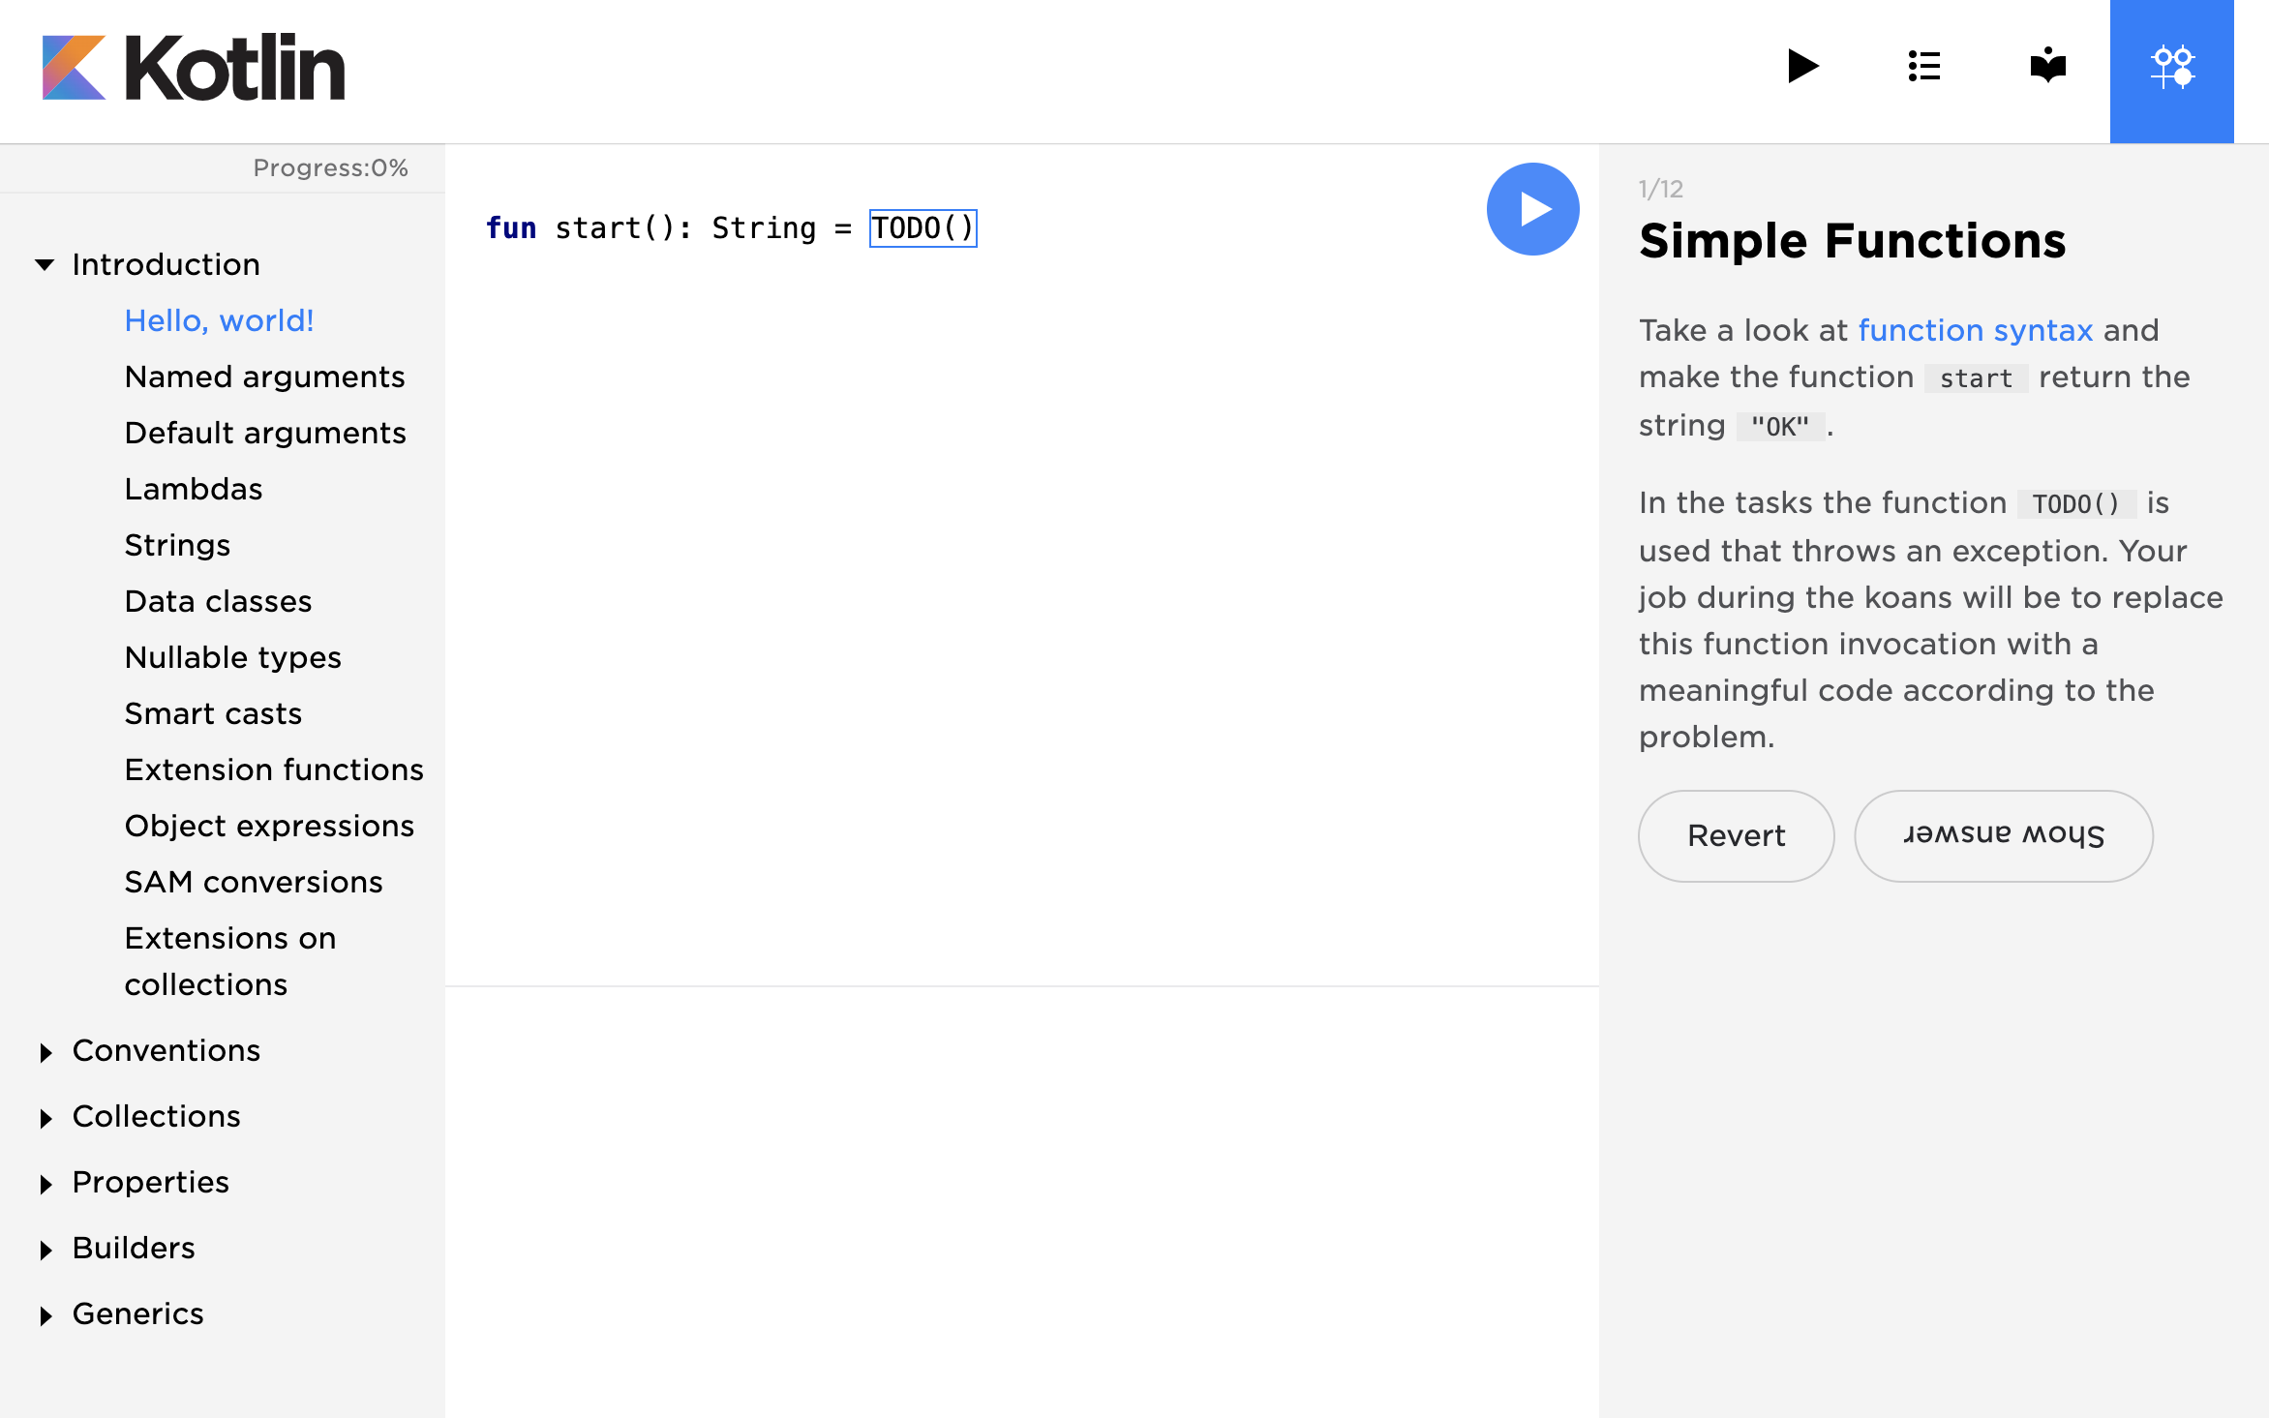
Kotlin Koans
Notes:
Once you click into a category and click into an exercise, the instructions for that exercise will appear on the right hand side. You’ll be typing your code in the middle. Some starter code will already be provided for you and you will type your answer in the places marked TODO().
When you think you have your answer, click the blue play button. Some unit tests will be run to verify your code. The output of these tests will show below your code. If you get stuck or want to start over with the original code provided in an exercise, click the Revert button. As you’re working, you can call me over if you have questions. If you truly get stuck, there is an option to Show answer, but use that as a last resort since you’ll remember the concepts much better if you can solve the Koan without looking at the answer.

Slide 27
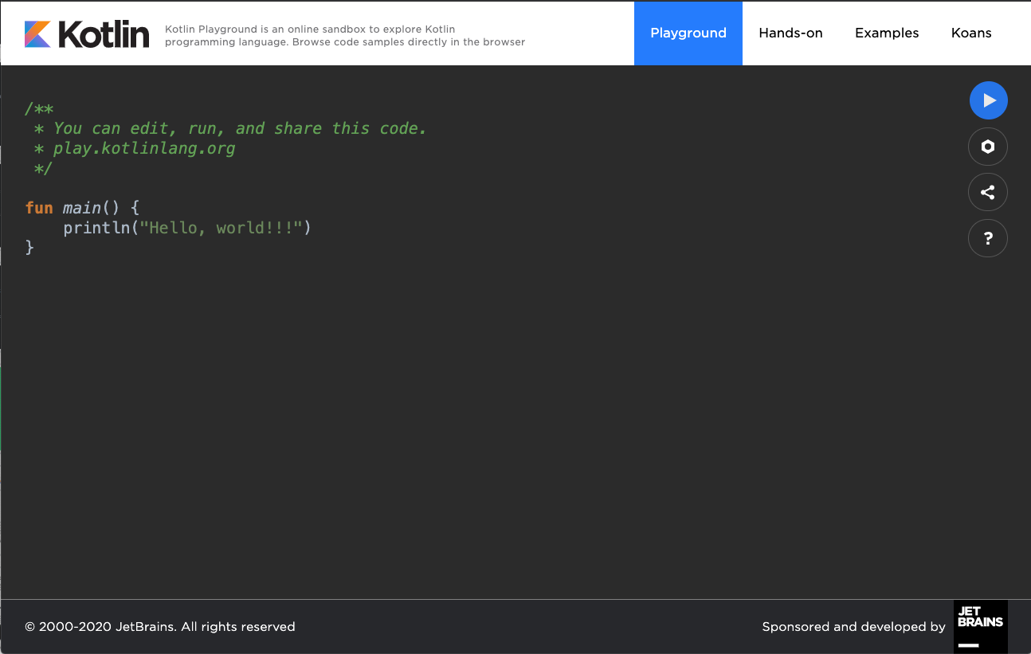
Kotlin Playground
Notes:
If you click the black “Play” button in the top menu bar, you will open the Kotlin Playground, which is another helpful tool. This allows you to practice writing and running Kotlin code, all within a web browser without needing to install an IDE.

Slide 28
What does this code do?
fun main() { println("Hello world!") print("Hello") }
Notes:
What does everyone think this code does?
[Continue to get audience participation until someone says “It prints Hello World!”.]

Slide 29
What does this code do?
fun main() { println("Hello world!") print("Hello!") }
>>> Hello world! >>> Hello!
Notes:
Right! It prints Hello world!

Slide 30
What do you notice about Kotlin?
fun main() { println("Hello world!") }
Notes:
But what are some things you notice about Kotlin?
[Continue to get audience participation until they mention these things.]
Functions are declared with the ‘fun’ keyword
Kotlin programs need a main() function
Kotlin uses curly braces to enclose a function body
Semicolons are not needed in Kotlin
println function is used to print a line of output to console
If after a few people speaking they’re not mentioning all of those listed above, you should jump in and say:]
Specifically, every Kotlin program requires a main() function. A function is declared by using the fun keyword in Kotlin, followed by the name of the method, input parameters in parentheses, and then the function body in curly braces. This function prints “Hello world!” to the console. Notice that there’s no semicolons needed.
The main() function in Kotlin can take in args as input, which is an array of strings. But the input args are optional and can be omitted as shown above, further simplifying this short program!

Slide 31
mutable variable
var counter = 5
immutable variable
val name: String = "Rebecca"
Notes:
Next, let’s discuss variables. You can declare variables with the var keyword (for mutable variables) or with the val keyword (for immutable variables).
Use var if you want change the value it’s assigned to, like a counter variable that would be updated.
Use val if you only need to assign the variable once. In this case, we don’t expect the name to change.
It is recommended to use val over var when possible.
Note that regardless of whether the keyword var or val was used, the objects themselves may still be mutable or not. For example, you can declare a mutable list with val myList = mutableListOf(). While the reference to the list doesn’t change, you can still add or remove items from myList.
For more info
https://kotlinlang.org/docs/reference/basic-syntax.html
https://play.kotlinlang.org/byExample/01_introduction/03_Variables

Slide 32
Parameters and Return Type
fun add(a: Int, b: Int): Int { return a + b }
Notes:
Here’s other examples of functions in Kotlin
Declare them with the fun keyword as you saw before. What’s new here is seeing how function parameters are defined. Following each parameter name, insert a colon followed by a space and then the data type of the parameter. After the parameters, insert a colon followed by a space and then the return type of the function (which is Int in this case). Within the function body, specify the return value of a function with the return keyword in Kotlin.
If there is no return value, you can specify Unit as the return type. Or for more concise code, you can just omit the return type from the function declaration, as you saw with the main() function earlier.
For more info
https://kotlinlang.org/docs/reference/functions.html

Slide 33
What’s interesting about these variable declarations?
var length = 5 val message = "Welcome"
Notes:
These are also valid ways to declare variables in Kotlin. What do you notice about this code?
[Get some audience participation]
No data type is specified. We didn’t need to specify that length is an integer or that message is a String. Kotlin supports type inference, which means you can omit the type in your code when the compiler can infer it. In this case, the Kotlin compiler can infer that length is an integer and message is a String. Type inference is a powerful feature in Kotlin and allows your code to be more concise!

Slide 34
if (score < 20) { println("Low") } else if (score < 70) { println("Medium") } else { println("High") }
when (x) { 0 -> endGame() 1 -> moveNext() 2 -> skipTurn() }
Notes:
Control flow statements in Kotlin may look similar to what you’ve seen in other languages, with some differences.
You can write if-else statements as shown here. If the condition within the parentheses is true, then that branch will be executed. If none of the conditions are met, then we fall into the else block.
You can also use the when keyword for conditionals, similar to a switch statement in Java. In this example, when x is equal to 0, call the endGame() function. When it’s equal to 1, call moveNext(). And so on. When statements can make your code more compact, instead of creating multiple if/else branches checking the value of a variable.
In Kotlin, you can also write for loops and while loops, which aren’t shown here but you can check the documentation for examples.
For more info
https://kotlinlang.org/docs/reference/control-flow.html
https://kotlinlang.org/docs/reference/basic-syntax.html#using-conditional-expressions
https://play.kotlinlang.org/byExample/02_control_flow/01_When

Slide 35
Classes
// This is the Square class // definition class Square(val side: Int) // This is a Square instance val s = Square(10) println(s.side)
side
Notes:
Kotlin supports both functional and object-oriented programming styles. For OOP, you can create classes and object instances as shown here.
Within a single line of code, we can define a class called Square, and it has one property: the length of its side.
Then, we instantiate a Square object instance with a length of 10 and store it in a variable called s. Looking at this code, what does this line s.side print?
[Answer should be 10]
For more info:
https://kotlinlang.org/docs/reference/classes.html

Slide 36
Collections
val numList = listOf(1, 2, 3) val numSet = setOf(4, 5, 6) val numMap = mapOf("a" to 10, "b" to 20, "b" to 30)
Notes:
The Kotlin Standard Library also offers a lot of functionality to help you manage and manipulate collections of items easily. You can create lists, sets, and maps for example.
This is just a brief overview of some of the basics of Kotlin and you’ll dive into more details in the hands-on part of this session.
For more info:
https://kotlinlang.org/docs/reference/collections-overview.html

Slide 37
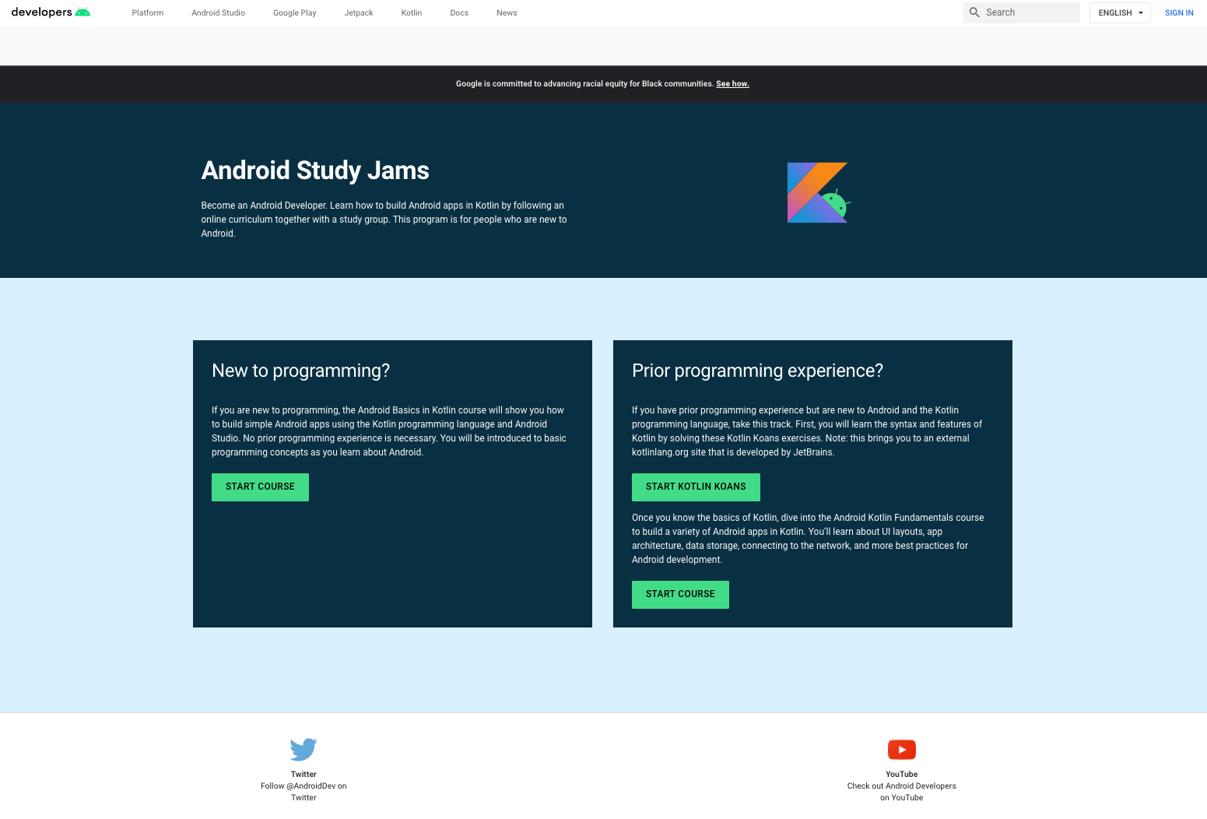
Prior Programming Experience track:
Start Kotlin Koans
Notes:
Then under the Prior Programming Experience track in the right hand box, click the green button to Start Kotlin Koans.
Note: Kotlin Koans is an external kotlinlang.org site that is developed by JetBrains.

Slide 38
Stuck? Ask for help
Go to g.co/android/studyjams and start Kotlin Koans
Introduction, Conventions, Collections
Run Code & Check Output
Check Error
Messages
Re-read Instructions
Exercises
Show Answers
Notes:
As a reminder, in this session, you’ll work on the Kotlin Koans only in these first 3 categories, as shown in the slide.
Introduction
Conventions
Collections
Go ahead and start by going to this link. We will be taking a break at <Insert Time>.
I’ll leave these tips up for what to do if you’re stuck. Or as always, I’m available to help if needed. [Mention other facilitators if those are available.]
[Leave this up as people work. You can let them work for about 45 minutes and then take a break.]

Slide 39
What did you notice about Kotlin?
Notes:
To reflect on what you’ve just learned, what did you notice about Kotlin? How is it similar or different to existing programming languages you may know?
[Ask for audience participation]

Slide 40

Share what you’ve
learned with #AndroidStudyJams
Notes:
Thank you so much for participating today, everyone! Hope you learned more about Kotlin and feel free to share what you learned on social media.
You can post photos or highlights from today’s session on social media using #AndroidStudyJams. [Include your own developer community and chapter hashtags (i.e. #developerstudentclubs #dsccmu)]

Slide 41

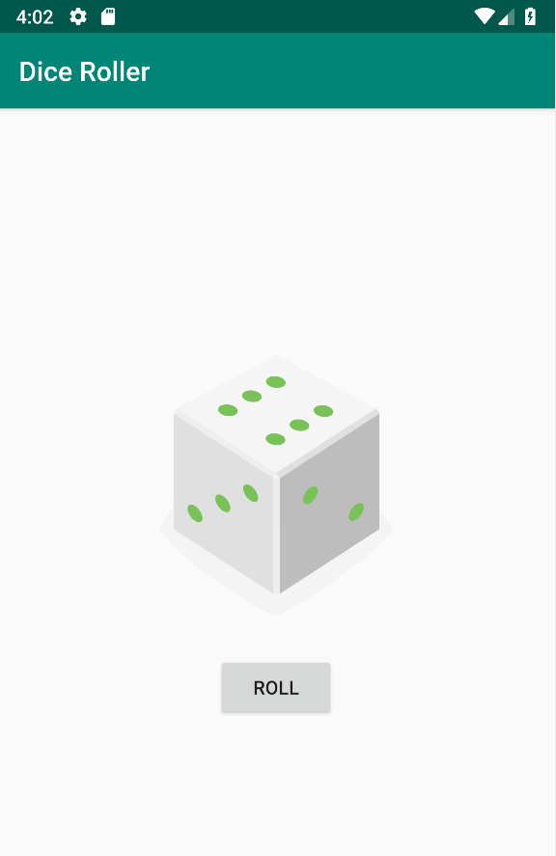
Stay tuned for Session 2
Notes:
I’m sure you’re eager to use your new skills in Kotlin and apply them to Android development! Stay tuned for our next session where you’ll start to build your first Android apps in Kotlin.
[Insert details about time and location of Session 2 if it’s on a different day than Session 1.]

